Slide 1

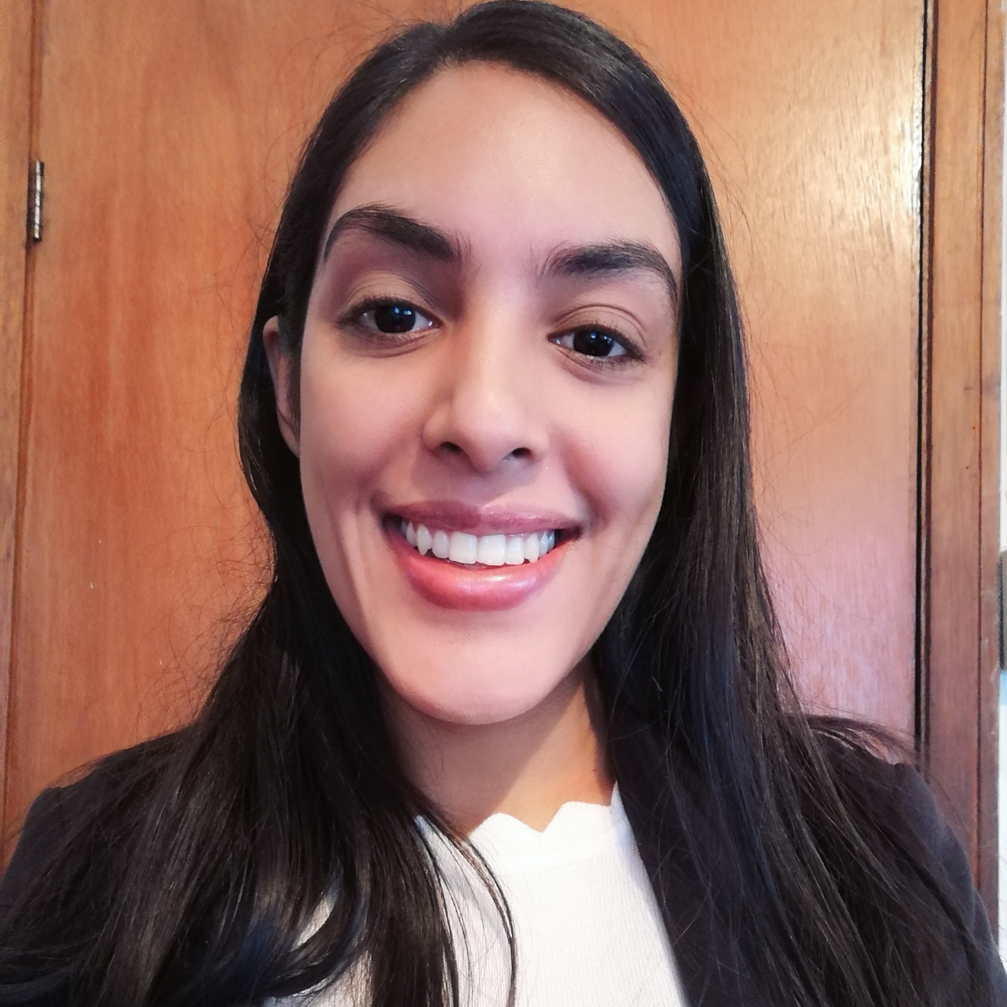

Experience
Areas of expertise
Application Development Associate (Nov 2020 – To Date)
Stream Outillage: Implementation of Azure devOps
Work items/Sprint/Backlog Planning
Strategy for CI/CD Pipelines/ Release continuous deployment
Git Repositories
Power Platform (Community Management & Assistance Citizen)
Power Apps: Canvas apps, model-driven apps, component libraries, connectors, ect
Power automate
Talent Supply Demand Associate (Aug 2019 – Oct 2020)
"Create and Optimize" resource planning
Weekly demand review
Headcount Planning
Resource Management via Myscheduling
Scorecard – Monthly reporting of headcount, new joiners, leavers
Resource chargeability Analysis via Power BI Dashboard
Functional
Candidate Management
Communication
Industries
Human Resource
Insurance
Technical
R Programming language
Microsoft Excel
Microsoft Power BI
Azure devOps
Sneha Reetun
Application Development Associate Mauritius Ebene
Email: sneha.reetun@accenture.com
Professional background
Education
BSc(Hons) Actuarial Studies
University of Mauritius, 2019
Microsoft Certified
PL-900 Microsoft Power Platform Fundamentals (Passed)
PL-100 Microsoft Power Platform App Maker (In Progress)
AZ-900 Microsoft Azure Fundamentals (In Progress)
Professional Experience(Accenture):
1 year as Talent Supply Demand Associate(Human Resources)
6 months-Present: Power Platform Practitioner
Internships(Non Accenture):
BCP Bank MRU (Back office duties)
Medscheme (Reporting & Analysis)
Metropolitan Life Ltd (Debtor)

